Slide 1
Task Scheduling using
Particle Swarm
Optimization Algorithm
Group members:-
Abhinav Rawat (0801EC181003)
Armit Singh Makhija (0801CS181014)
Gurpreet Singh (0801CS181028)
Keshav Singi (0801CS181031)
Ritik Gandhi (0801CS181066)
Submitted to:-
Dr. Sonika Shrivastava

Slide 2


Slide 3
The basic idea
Each particle is searching for the optimum
Each particle is moving and hence has a velocity.
Each particle remembers the position it was in where it had its best result so far (its personal best)
But this would not be much good on its own; particles need help in figuring out where to search.

Slide 4
The basic idea
The particles in the swarm co-operate. They exchange information about what they’ve discovered in the places they have visited
The cooperation is very simple. In basic PSO it is like this:
– A particle has a neighbourhood associated with it.
– A particle knows the fitnesses of those in its neighbourhood, and uses the position of the one with best fitness.
–This position is simply used to adjust the particle’s velocity

Slide 5
What a particle does
In each timestep, a particle has to move to a new position. It does this by adjusting its velocity.
–The adjustment is essentially this:
–The current velocity PLUS
– A weighted random portion in the direction of its personal best PLUS
–A weighted random portion in the direction of the neighbourhood best.
Having worked out a new velocity, its position is simply its old position plus the new velocity.

Slide 6
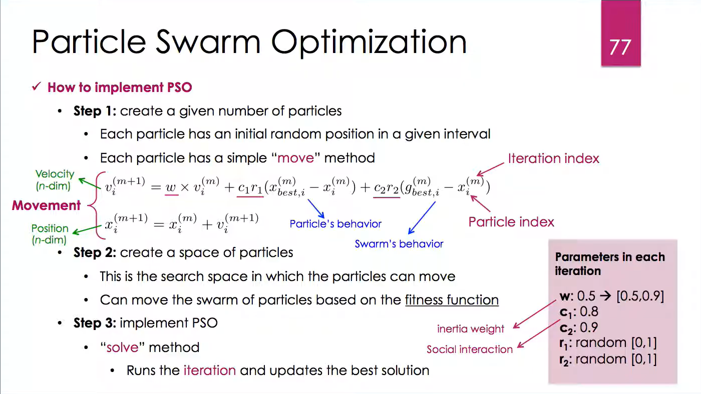

Slide 7
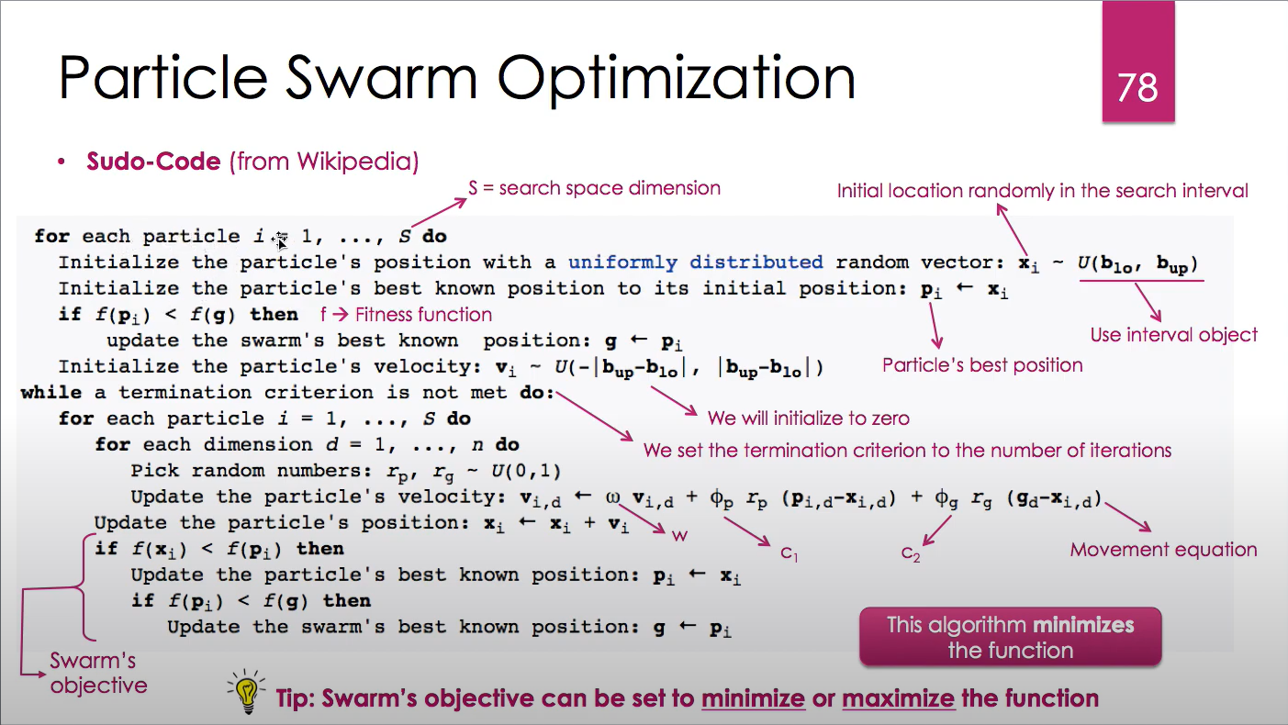

Slide 8
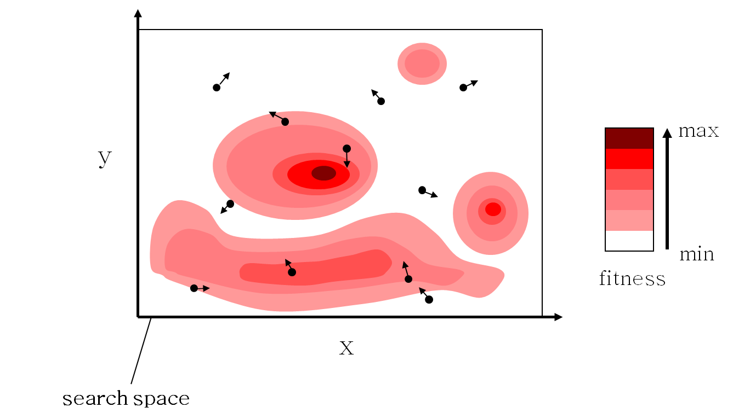

Slide 9
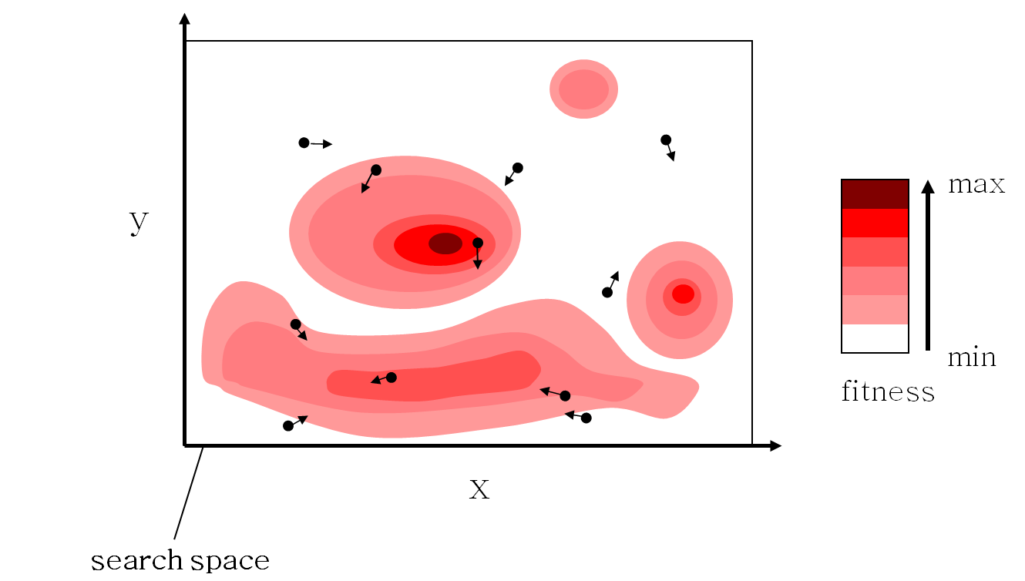

Slide 10
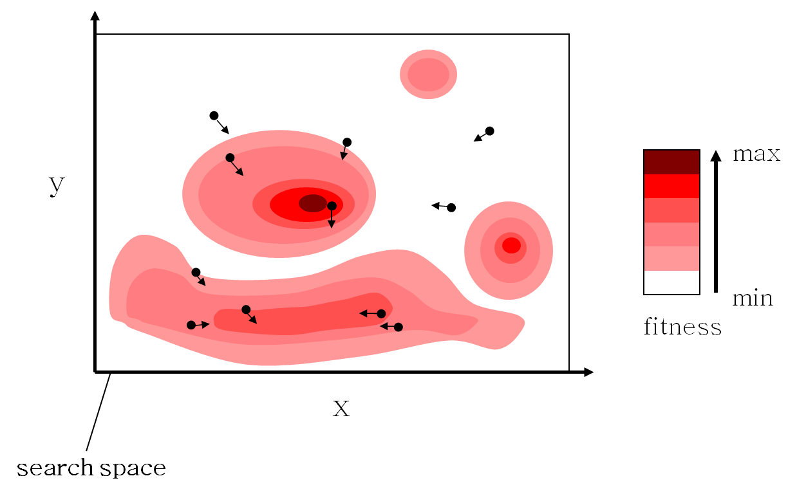

Slide 11


Slide 12


Slide 13
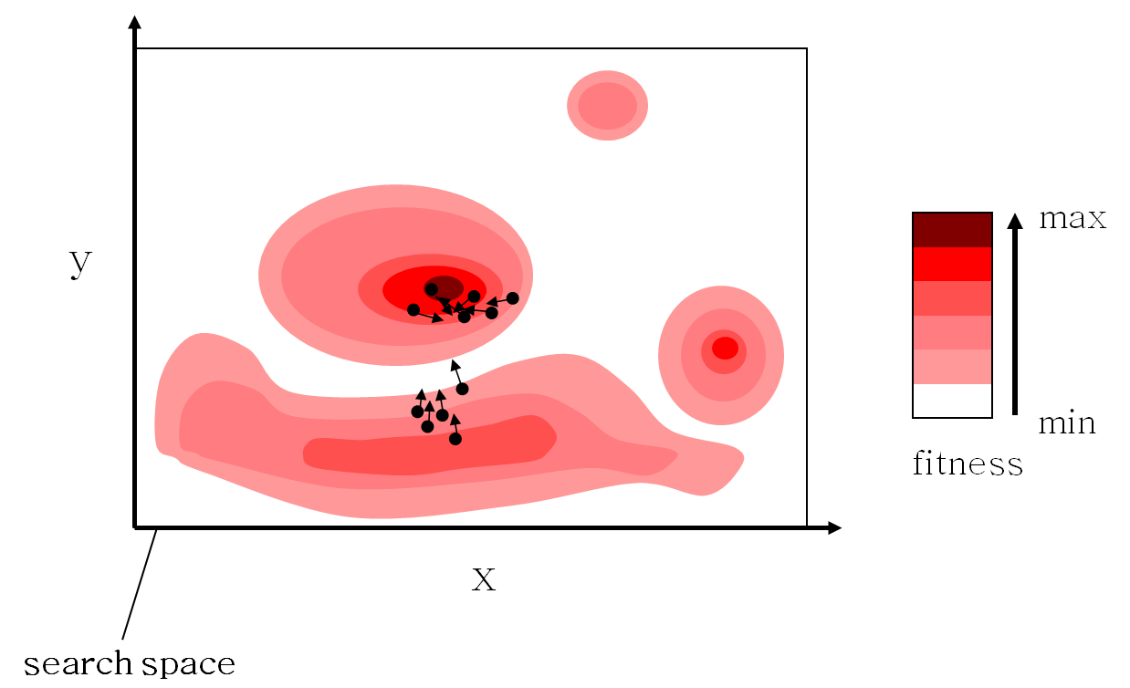

Slide 14


Slide 15


Slide 17
Advantages of PSO
Insensitive to scaling of design variables
Simple implementation
Easily parallelized for concurrent processing
Derivative free
Very few algorithm parameters
Very efficient global search algorithm
Disadvantages of PSO
Tendency to a fast and premature convergence in mid optimum points
Slow convergence in refined search stage (weak local search ability)

Slide 18
Implementation

Slide 19
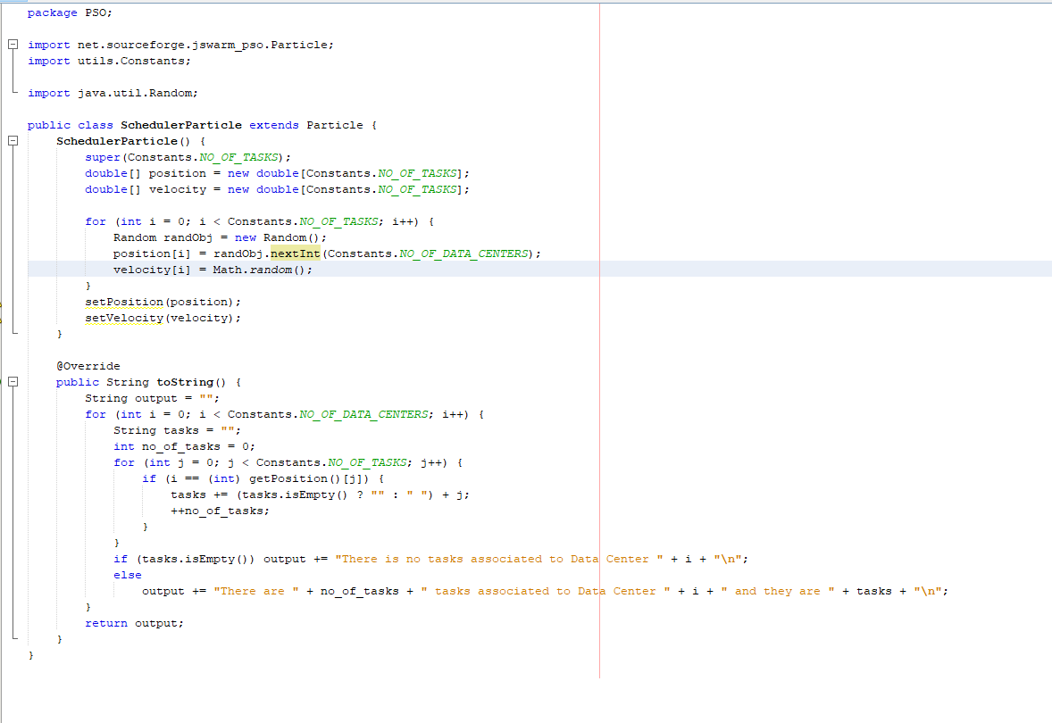

Slide 20
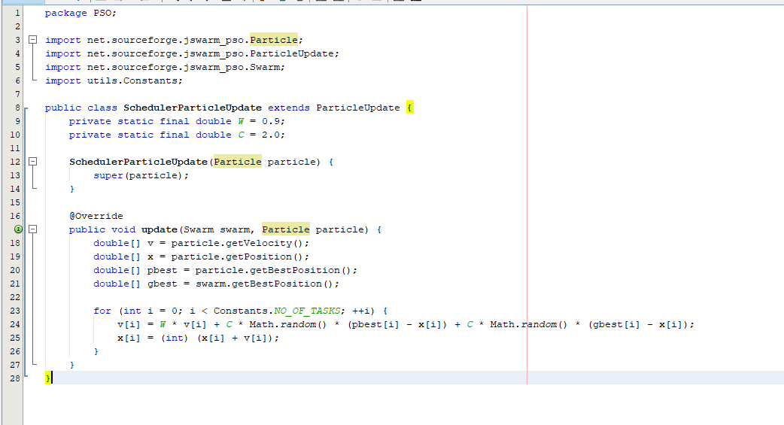

Slide 21
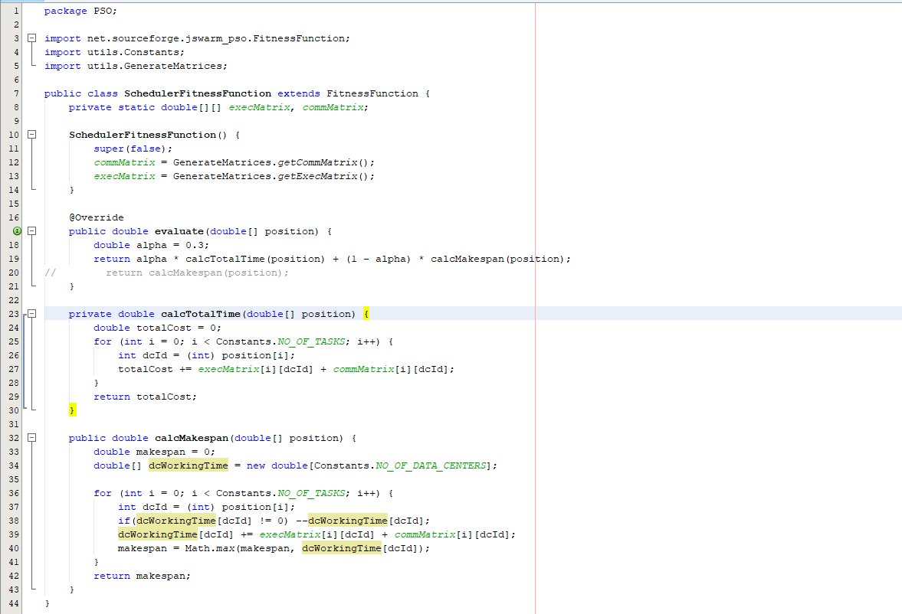

Slide 22
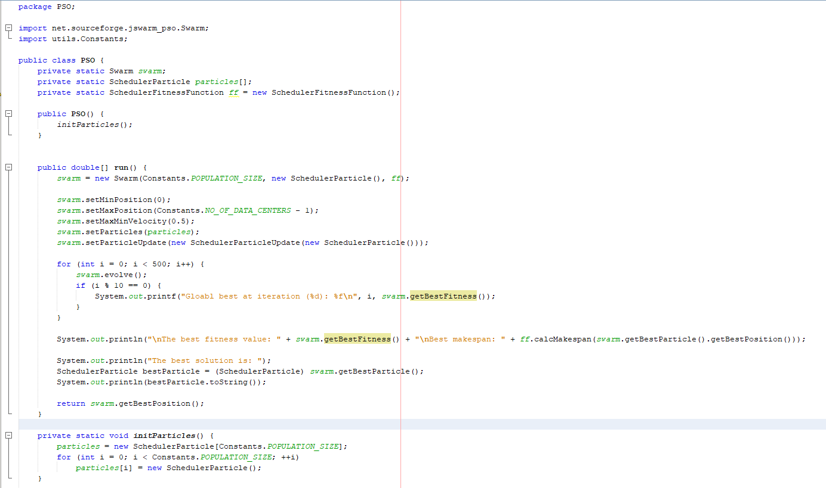

Slide 23
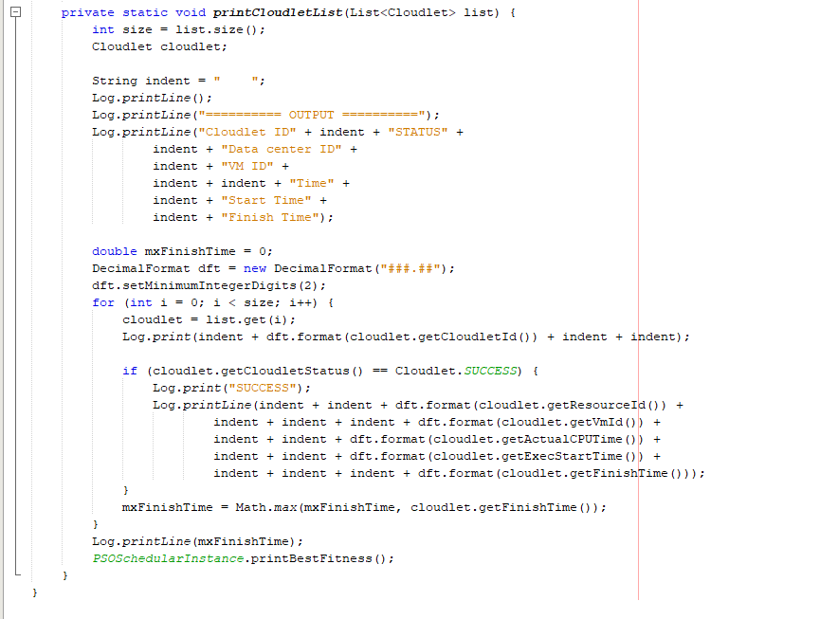

Slide 24
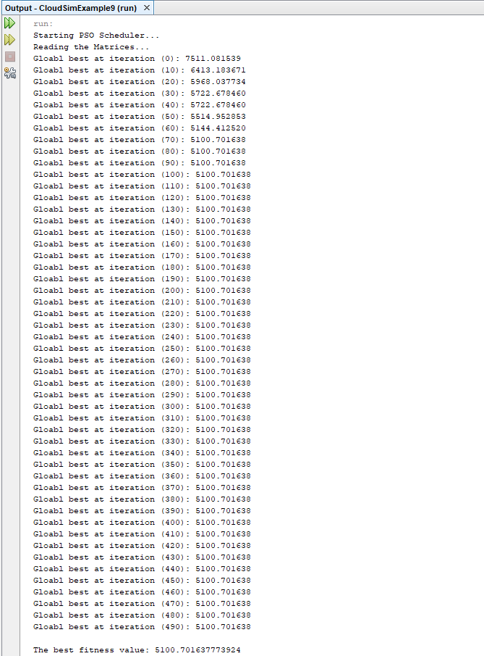
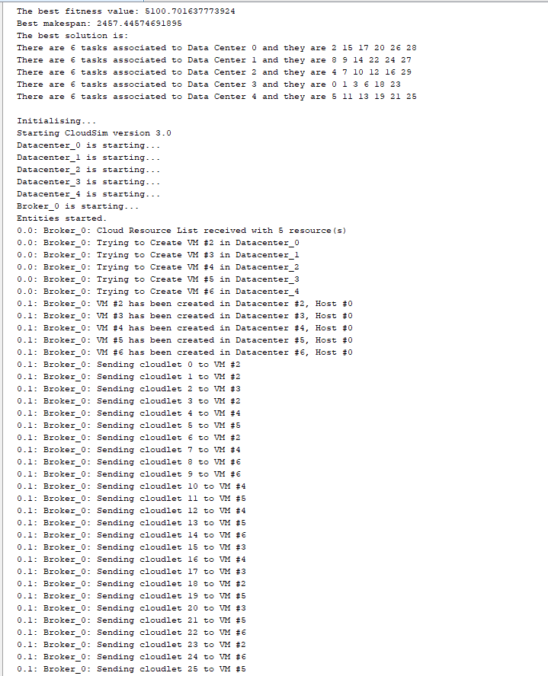

Slide 25
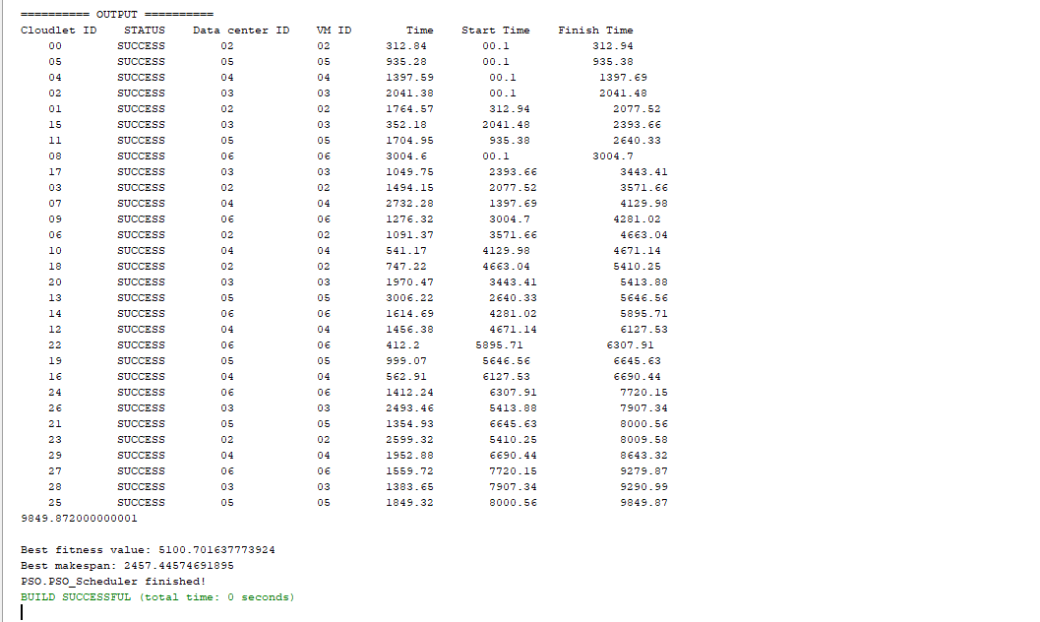

Slide 26


